Slide 1
Data Processing Programming
Introduction to Libraries for Data Processing
Overview of NumPy and Pandas, installing libraries
Lecturer: Shakhnoza Muksimova
18.09.2025

Slide 2
Outline
NumPy
Pandas

Slide 3
INTRODUCTION TO NUMPY

Slide 4
What is NumPy?
NumPy is a general-purpose array-processing package.
It provides a high-performance multidimensional array object and tools for working with these arrays.
It is the fundamental package for scientific computing with Python. It is open-source software.

Slide 5
Features of NumPy
NumPy has various features which make them popular over lists.
Some of these important features include:
A powerful N-dimensional array object
Sophisticated (broadcasting) functions
Tools for integrating C/C++ and Fortran code
Useful linear algebra, Fourier transform, and random number capabilities

Slide 6
Applications of NumPy
Mathematics
Plotting
Backend(Pandas, connect 4, digital photography OpenCV)
Machine Learning

Slide 7
How to import NumPy
To access NumPy and its functions import it in your Python code like this:
import numpy as np

Slide 8
How to install Numpy in Python 3.12
https://www.youtube.com/watch?v=3qJhtD884S8

Slide 9
Why use NumPy?
NumPy arrays are faster and more compact than Python lists.
An array consumes less memory and is convenient to use.
NumPy uses much less memory to store data and it provides a mechanism of specifying the data types.
This allows the code to be optimized even further.

Slide 10
NumPy Array in Python
Python lists are a substitute for arrays, but they fail to deliver the performance required while computing large sets of numerical data.
To address this issue we use the NumPy library of Python. NumPy offers an array object called ndarray.
They are similar to standard Python sequences but differ in certain key factors.

Slide 11
What is a NumPy Array?
NumPy array is a multi-dimensional data structure that is the core of scientific computing in Python.
All values in an array are homogenous (of the same data type).
They offer automatic vectorization and broadcasting.
They provide efficient memory management, ufuncs(universal functions), support various data types, and are flexible with Indexing and slicing.

Slide 12
Dimensionalities of array:
Name | Example
0D (zero-dimensional) | Scalar – A single element
1D (one-dimensional) | Vector- A list of integers.
2D (two-dimensional) | Matrix- A spreadsheet of data
3D (three-dimensional) | Tensor- Storing a color image

Slide 13
What’s the difference between a Python list and a NumPy array?
NumPy gives you an enormous range of fast and efficient ways of creating arrays and manipulating numerical data inside them.
While a Python list can contain different data types within a single list, all of the elements in a NumPy array should be homogeneous.
The mathematical operations that are meant to be performed on arrays would be extremely inefficient if the arrays weren’t homogeneous.

Slide 14
Comparison between Numpy array and Python List

Slide 15
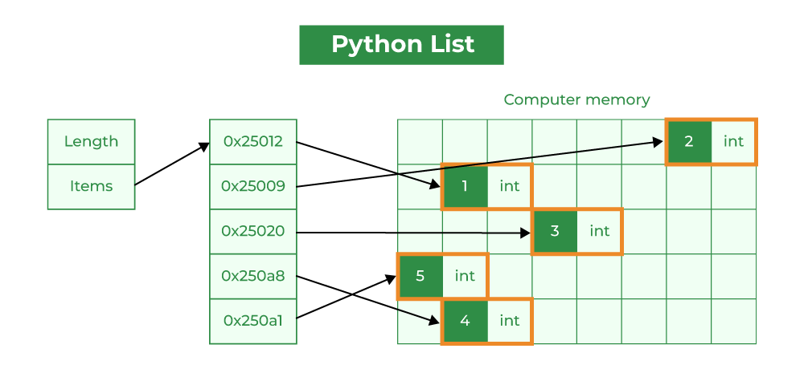
Python Lists
Element Overhead: Lists in Python store additional information about each element, such as its type and reference count. This overhead can be significant when dealing with a large number of elements.
Datatype: Lists can hold different data types, but this can decrease memory efficiency and slow numerical operations.
Memory Fragmentation: Lists may not store elements in contiguous memory locations, causing memory fragmentation and inefficiency.
Performance: Lists are not optimized for numerical computations and may have slower mathematical operations due to Python’s interpretation overhead. They are generally used as general-purpose data structures.
Functionality: Lists can store any data type, but lack specialized NumPy functions for numerical operations.

Slide 16
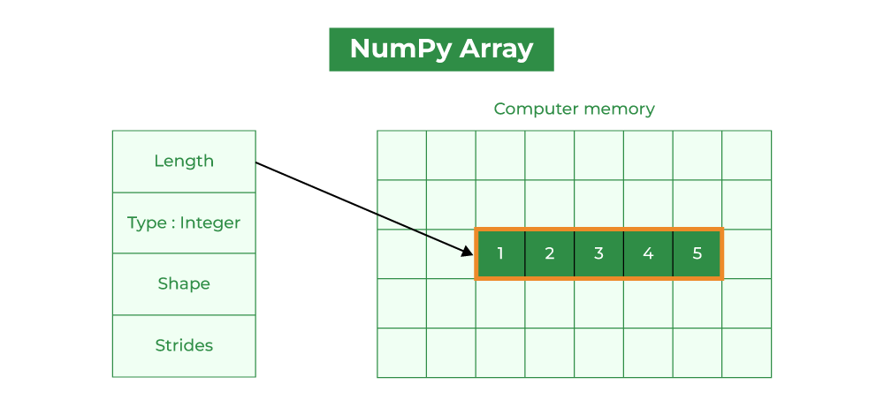
Numpy Arrays
Homogeneous Data: NumPy arrays store elements of the same data type, making them more compact and memory-efficient than lists.
Fixed Data Type: NumPy arrays have a fixed data type, reducing memory overhead by eliminating the need to store type information for each element.
Contiguous Memory: NumPy arrays store elements in adjacent memory locations, reducing fragmentation and allowing for efficient access.
Array Metadata: NumPy arrays have extra metadata like shape, strides, and data type. However, this overhead is usually smaller than the per-element overhead in lists.
Performance: NumPy arrays are optimized for numerical computations, with efficient element-wise operations and mathematical functions. These operations are implemented in C, resulting in faster performance than equivalent operations on lists.

Slide 17
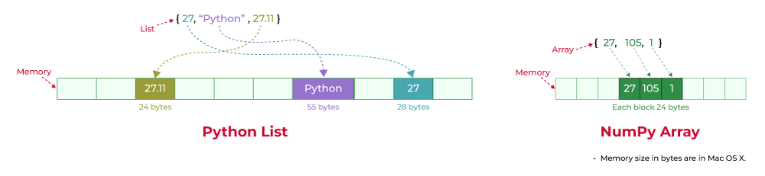
Memory consumption between Numpy array and lists
In Python, a list is a built-in data structure that can hold elements of varying data types. However, the flexibility of lists comes at the cost of memory efficiency.
Python’s NumPy library supports optimized numerical array and matrix operations.

Slide 18
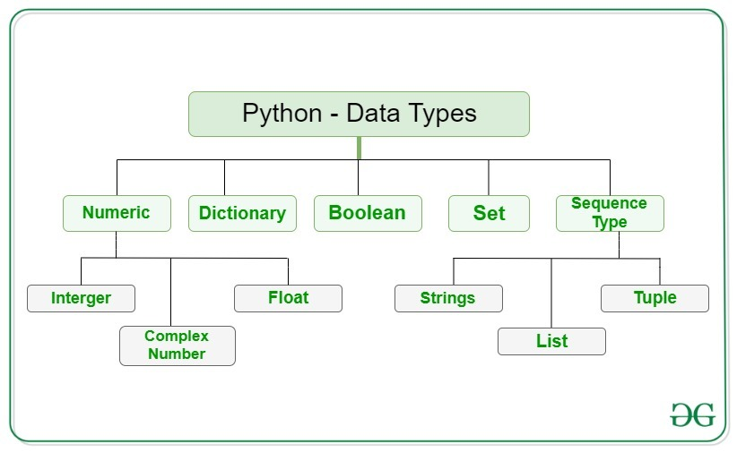

Slide 19
# DataType Output: str
x = "Hello World"
# DataType Output: int
x = 50
# DataType Output: float
x = 60.5
# DataType Output: complex
x = 3j
# DataType Output: list
x = ["geeks", "for", "geeks"]
# DataType Output: tuple
x = ("geeks", "for", "geeks")
# DataType Output: range
x = range(10)
# DataType Output: dict
x = {"name": "Suraj", "age": 24}
# DataType Output: set
x = {"geeks", "for", "geeks"}
# DataType Output: frozenset
x = frozenset({"geeks", "for", "geeks"})
# DataType Output: bool
x = True
# DataType Output: bytes
x = b"Geeks"
# DataType Output: bytearray
x = bytearray(4)
# DataType Output: memoryview
x = memoryview(bytes(6))
# DataType Output: NoneType
x = None

Slide 20
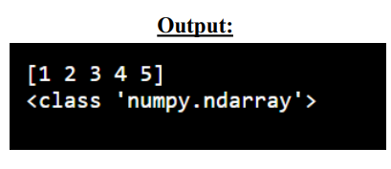
Create a NumPy ndarray Object
using the array() function
import numpy as np
arr = np.array([1, 2, 3, 4, 5])
print(arr)
print(type(arr))

Slide 21
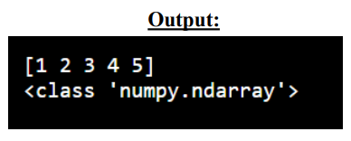
Create a NumPy ndarray Object
Use a tuple to create a NumPy array:
import numpy as np
arr = np.array((1, 2, 3, 4, 5))
print(arr)
print(type(arr))

Slide 22
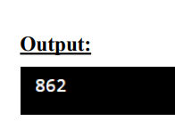
Dimensions in Arrays
0-D Arrays
The elements in array are 0-D arrays, or Scalars.
Example: Create a 0-D array with value 862
import numpy as np
arr = np.array(862)
print(arr)

Slide 23
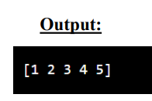
Dimensions in Arrays
1-D Arrays
An array that has 1-D arrays as its elements is called uni-dimensional or 1-D array.
Example: Create a 0-D array with value 1,2,3,4,5
import numpy as np
arr = np.array([1,2,3,4,5])
print(arr)

Slide 24
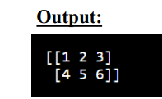
Dimensions in Arrays (2-D)
An array that has 1-D arrays as its elements is called two-dimensional or 2-D array.
Example: Create a 2-D array with values 1,2,3 and 4,5,6
import numpy as np
arr = np.array([[1,2,3],[4,5,6]])
print(arr)

Slide 25
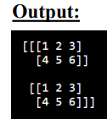
Dimensions in Arrays (3-D)
An array that has 2-D arrays as its elements is called three-dimensional or 3-D array.
Example: Create a 3-D array with 2 D array values 1,2,3 and 4,5,6
import numpy as np
arr = np.array([[[1,2,3],[4,5,6]], [[1,2,3],[4,5,6]]])
print(arr)

Slide 26
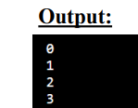
Check Number of Dimensions?
NumPy Arrays provides the ndim attribute that returns an integer that tells us how
many dimensions the array have.
import numpy as np
a = np.array(42)
b = np.array([1, 2, 3, 4, 5])
c = np.array([[1, 2, 3], [4, 5, 6]])
d = np.array([[[1, 2, 3], [4, 5, 6]], [[1, 2, 3], [4, 5, 6]]])
print(a.ndim)
print(b.ndim)
print(c.ndim)
print(d.ndim)

Slide 27
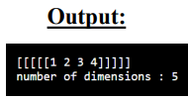
Higher Dimensional Arrays
An array can have any number of dimensions.
When the array is created, we can define the number of dimensions by using the ndmin argument.
import numpy as np
arr = np.array([1, 2, 3, 4], ndmin=5)
print(arr)
print('number of dimensions :', arr.ndim)

Slide 28
Array Indexing
Get the first element from a 1D array
Get third and fourth elements from a 1D array and add them.
To access elements from 2-D arrays we can use comma separated integers representing the dimension and the index of the element.
Access the element on the first row, second column
Access the element on the 2nd row, 5th column

Slide 29
Array Indexing
To access elements from 3-D arrays we can use comma separated integers representing the dimensions and the index of the element.
Access the third element of the second array of the first array
Negative Indexing
Use negative indexing to access an array from the end.

Slide 30
Numpy Datatypes

Slide 31
Data Types in Python
By default Python have these data types:
Strings - used to represent text data
Integer - used to represent integer numbers.
Float - used to represent real numbers.
Boolean - used to represent true or false.
Complex - used to represent complex numbers.

Slide 32
Data Types in NumPy
NumPy has some extra data types, and refer to data types with one character
i - integer
b - boolean
u - unsigned integer
f - float
c - complex float
m - timedelta
M - datetime
O - object
S - string
U - unicode string
V - fixed chunk of memory for other type ( void )

Slide 33
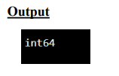
Checking the Data Type of an Array
The NumPy array object has a property called dtype that returns the data type of the array:
Example:
import numpy as np
arr = np.array([1, 2, 3, 4])
print(arr.dtype)

Slide 34
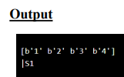
Creating Arrays With a Defined Data Type
Use array() function to create arrays, this can take an optional argument: dtype to define the expected data type of the array elements:
Example:
import numpy as np
arr = np.array([1, 2, 3, 4], dtype='S’)
print(arr)
print(arr.dtype)

Slide 35

The best way to change the data type of an existing array, is to make a copy of the array with the astype() method.
The astype() function creates a copy of the array, and allows you to specify the data type as a parameter.
Example:
import numpy as np
arr = np.array([1.1, 2.1, 3.1])
newarr = arr.astype('i’)
print(newarr)
print(newarr.dtype)
Converting Data Type on Existing Arrays

Slide 36
NumPy Array Copy vs View
The main difference between a copy and a view of an array is that the copy is a new array, and the view is just a view of the original array.
The copy owns the data and any changes made to the copy will not affect original array, and any changes made to the original array will not affect the copy.
The view does not own the data and any changes made to the view will affect the original array, and any changes made to the original array will affect the view.

Slide 37
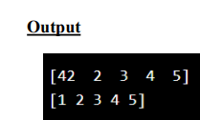
NumPy Array Copy vs View
Example:
Copy
import numpy as np
arr = np.array([1, 2, 3, 4, 5])
x = arr.copy()
arr[0] = 42
print(arr)
print(x)

Slide 38
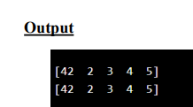
NumPy Array Copy vs View
Example:
VIEW
import numpy as np
arr = np.array([1, 2, 3, 4, 5])
x = arr.view()
arr[0] = 42
print(arr)
print(x)

Slide 39
Array Slicing
Taking elements from one given index to another given index.
We pass slice instead of index like this: [start:end].
We can also define the step, like this: [start:end:step].
If we don't pass start it’s considered 0
If we don't pass end it’s considered length of array in that dimension
If we don't pass step it’s considered 1

Slide 40
Array Slicing
Example:
import numpy as np
arr = np.array([1, 2, 3, 4, 5, 6, 7])
//Slice elements from index 1 to index 5
print(arr[1:5])
Example:
import numpy as np
arr = np.array([1, 2, 3, 4, 5, 6, 7])
//Slice elements from index 4 to the end of the array:
print(arr[4:])

Slide 41
Example:
import numpy as np
arr = np.array([1, 2, 3, 4, 5, 6, 7])
//Slice elements from the beginning to index 4 (not included):
print(arr[:4])
Example:
import numpy as np
arr = np.array([1, 2, 3, 4, 5, 6, 7])
print(arr[-3:-1])

Slide 42
Example:
import numpy as np
arr = np.array([1, 2, 3, 4, 5, 6, 7])
//Return every other element from index 1 to index 5:
print(arr[1:5:2])
//Return every other element from the entire array:
print(arr[::2])

Slide 43
Slicing 2-D Arrays
Taking array and elements from one given index to another given index.
We pass slice instead of index like this:[array index, start:end].
We can also define the step, like this: [array index, start:end:step].
2 D array has two 1D arrays
array index 0 for first 1D array
array index 1 for first 1D array

Slide 44


Slicing 2-D Arrays
Example:
import numpy as np
arr = np.array([[1, 2, 3, 4, 5], [6, 7, 8, 9, 10]])
//From the second element, slice elements from index 1 to index 4 (not included):
print(arr[1,1:4])
Example:
import numpy as np
arr = np.array([[1, 2, 3, 4, 5], [6, 7, 8, 9, 10]])
//From both elements, return index 2:
print(arr[0:2,2])

Slide 45
Example:
import numpy as np
arr = np.array([[1, 2, 3, 4, 5], [6, 7, 8, 9, 10]])
//From both elements, slice index 1 to index 4 (not included):
print(arr[0:2,1:4])

Slide 46

Array Shape
Shape of an Array
The shape of an array is the number of elements in each dimension.
NumPy arrays have an attribute called shape that returns a tuple with each index having the number of corresponding elements.
Example:
import numpy as np
arr = np.array([[1, 2, 3, 4], [5, 6, 7, 8]])
print(arr.shape)

Slide 47
Array Reshaping
Reshaping means changing the shape of an array.
The shape of an array is the number of elements in each dimension.
By reshaping we can add or remove dimensions or change number of elements in each dimension.

Slide 48
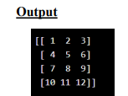
Reshape From 1-D to 2-D
Example:
Convert the following 1-D array with 12 elements into a 2-D array.
import numpy as np
arr = np.array([1, 2, 3, 4, 5, 6, 7, 8, 9, 10, 11, 12])
newarr = arr.reshape(4, 3)
//The outermost dimension will have 4 arrays, each with 3 elements:
print(newarr)

Slide 49
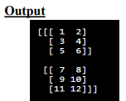
Reshape From 1-D to 3-D
Example:
Convert the following 1-D array with 12 elements into a 3-D array.
import numpy as np
arr = np.array([1, 2, 3, 4, 5, 6, 7, 8, 9, 10, 11, 12])
newarr = arr.reshape(2, 3,2)
//The outermost dimension will have 2 arrays that contain 3 arrays, each with 2 elements:
print(newarr)

Slide 50
Unknown Dimension
You are allowed to have one "unknown" dimension.
Do not specify an exact number for one of the dimensions in the reshape method.
Pass -1 as the value, and NumPy will calculate this number for you.

Slide 51
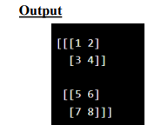
Unknown Dimension
Example:
import numpy as np
arr = np.array([1, 2, 3, 4, 5, 6, 7, 8])
newarr = arr.reshape(2, 2, -1)
print(newarr)
//Convert 1D array with 8 elements to 3D array with 2x2 elements:

Slide 52
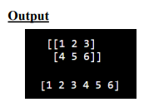
Flattening the arrays
Means converting a multidimensional array into a 1D array.
Use reshape(-1) to do this.
Example:
import numpy as np
arr = np.array([[1, 2, 3], [4, 5, 6]])
print(arr) newarr = arr.reshape(-1)
//Convert the array into a 1D array:
print(newarr)

Slide 53
Array Iterating

Slide 54

Iterating Arrays
Iterating means going through elements one by one.
As we deal with multi-dimensional arrays in numpy, we can do this using basic for loop of python.
If we iterate on a 1-D array it will go through each element one by one.
Example:
import numpy as np
arr = np.array([1, 2, 3])
for x in arr:
print(x)

Slide 55

Iterating 2-D Arrays
In a 2-D array it will go through all the rows.
Example:
import numpy as np
arr = np.array([[1, 2, 3], [4, 5, 6]])
for x in arr:
print(x)
If we iterate on a n-D array it will go through n-1th dimension one by one.

Slide 56
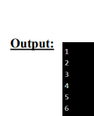
Iterating 2-D Arrays
To return the actual values, the scalars, we have to iterate the arrays in each dimension.
Example:
import numpy as np
arr = np.array([[1, 2, 3], [4, 5, 6]])
for x in arr:
for y in x:
print(y)

Slide 57
Iterating 3-D Arrays
In a 3-D array it will go through all 2D arrays.
Example:
import numpy as np
arr = np.array([[[1, 2, 3], [4, 5, 6]], [[7, 8, 9], [10, 11, 12]]])
for x in arr:
print(x)
[[1 2 3]
[4 5 6]]
[[ 7 8 9]
[10 11 12]]

Slide 58
Iterating 3-D Arrays
In a 3-D array it will go through all 2D arrays.
Example:
import numpy as np
arr = np.array([[[1, 2, 3], [4, 5, 6]], [[7, 8, 9], [10, 11, 12]]])
for x in arr:
for y in x:
for z in y:
print(z)
1
2
3
4
5
6
7
8
9
10
11
12

Slide 59

Iterating Arrays Using nditer()
Example 1:
import numpy as np
arr = np.array([[[1, 2], [3, 4]], [[5, 6], [7, 8]]])
for x in np.nditer(arr):
print(x)

Slide 60

Iterating With Different Step Size
Iterate through every scalar element of the 2D array skipping 1 element:
import numpy as np
arr = np.array([[1, 2, 3, 4], [5, 6, 7, 8]])
for x in np.nditer(arr[:, ::2]):
print(x)
Output

Slide 61
Joining Array

Slide 62
Joining NumPy Arrays
Joining means putting contents of two or more arrays in a single array.
In SQL we join tables based on a key, whereas in NumPy we join arrays by axes.
We pass a sequence of arrays that we want to join to the concatenate() function, along with the axis, If axis is not explicitly passed, it is taken as 0.

Slide 63
Joining NumPy Arrays
Example: Join two arrays
import numpy as np
arr1 = np.array([1, 2, 3])
arr2 = np.array([4, 5, 6])
arr = np.concatenate((arr1, arr2))
print(arr)
[1 2 3 4 5 6]

Slide 64
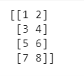
Joining NumPy Arrays
Example: Join two 2-D arrays:
import numpy as np
arr1 = np.array([[1, 2], [3, 4]])
arr2 = np.array([[5, 6], [7, 8]])
arr = np.concatenate((arr1, arr2))
print(arr)

Slide 65

Joining NumPy Arrays
Example: Join two 2-D arrays along rows (axis=1):
import numpy as np
arr1 = np.array([[1, 2], [3, 4]])
arr2 = np.array([[5, 6], [7, 8]])
arr = np.concatenate((arr1, arr2), axis=1)
print(arr)

Slide 66
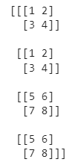
Joining NumPy Arrays
Example: Join two 3-D arrays:
import numpy as np
arr1 = np.array([[[1, 2], [3, 4]],[[1, 2], [3, 4]]])
arr2 = np.array([[[5, 6], [7, 8]],[[5, 6], [7, 8]]])
arr = np.concatenate((arr1, arr2),axis=0)
print(arr)

Slide 67
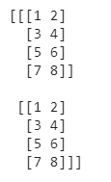
Joining NumPy Arrays
Example: Join two 3-D arrays:
import numpy as np
arr1 = np.array([[[1, 2], [3, 4]],[[1, 2], [3, 4]]])
arr2 = np.array([[[5, 6], [7, 8]],[[5, 6], [7, 8]]])
arr = np.concatenate((arr1, arr2),axis=1)
print(arr)

Slide 68
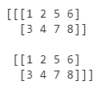
Joining NumPy Arrays
Example: Join two 3-D arrays:
import numpy as np
arr1 = np.array([[[1, 2], [3, 4]],[[1, 2], [3, 4]]])
arr2 = np.array([[[5, 6], [7, 8]],[[5, 6], [7, 8]]])
arr = np.concatenate((arr1, arr2),axis=2)
print(arr)

Slide 69
Joining Arrays Using Stack Functions
Stacking is same as concatenation, the only difference is that stacking is done along a new axis.
We can concatenate two 1-D arrays along the second axis which would result in putting them one over the other, i.e,. stacking.
We pass a sequence of arrays that we want to join to the stack() method along with the axis. If axis is not explicitly passed it is taken as 0 (default).

Slide 70

Joining Arrays Using Stack Functions
Stack Two 1D arrays:
import numpy as np
arr1 = np.array([1, 2, 3])
arr2 = np.array([4, 5, 6])
arr = np.stack((arr1, arr2), axis=1)
print(arr)

Slide 71

Joining Arrays Using Stack Functions
Stacking Along Rows:
NumPy provides a helper function: hstack() to stack along rows.
import numpy as np
arr1 = np.array([1, 2, 3])
arr2 = np.array([4, 5, 6])
arr = np.hstack((arr1, arr2))
print(arr)

Slide 72

Joining Arrays Using Stack Functions
Stacking Along Colum:
NumPy provides a helper function: vstack() to stack along coloum.
import numpy as np
arr1 = np.array([1, 2, 3])
arr2 = np.array([4, 5, 6])
arr = np.vstack((arr1, arr2))
print(arr)

Slide 73

Joining Arrays Using Stack Functions
Stacking Along Height (depth)
NumPy provides a helper function: dstack() to stack along height, which is the same as depth.
import numpy as np
arr1 = np.array([[1, 2, 3])
arr2 = np.array([4, 5, 6])
arr = np.dstack((arr1, arr2))
print(arr)

Slide 74
Universal Functions

Slide 75
ufuncs are used to implement vectorization in NumPy which is way faster than iterating over elements.
They also provide broadcasting and additional methods like reduce, accumulate etc. that are very helpful for computation.
ufuncs also take additional arguments, like:
where boolean array or condition defining where the operations should take place.
dtype defining the return type of elements.
out output array where the return value should be copied.

Slide 76
Vectorization
Converting iterative statements into a vector based operation is called vectorization.
It is faster as modern CPUs are optimized for such operations.
Add the Elements of Two Lists
list 1: [1, 2, 3, 4]
list 2: [4, 5, 6, 7]
One way of doing it is to iterate over both of the lists and then sum each elements.

Slide 77
Example
Without ufunc, we can use Python's built-in zip() method:
x = [1, 2, 3, 4]
y = [4, 5, 6, 7,9]
z = []
for i, j in zip(x, y):
z.append(i + j)
print(z)
OUTPUT
[5, 7, 9, 11]

Slide 78
NumPy has a ufunc for this, called add(x, y) that will produce the same result.
Example
With ufunc, we can use the add() function:
import numpy as np
x = [1, 2, 3, 4]
y = [4, 5, 6, 7]
z = np.add(x, y)
print(z)
OUTPUT
[5, 7, 9, 11]

Slide 79
Create Your Own ufun
define a function like normal python program
add it to your NumPy ufunc library with the frompyfunc() method
The frompyfunc() method takes the following arguments:
Function name - the name of the function we defined.
inputs - the number of input arguments (arrays) to be passed.
outputs - the number of output arrays returned.

Slide 80
import numpy as np
def myadd(x, y):
return x+y
myadd = np.frompyfunc(myadd, 2, 1)
print(myadd([1, 2, 3, 4], [5, 6, 7, 8]))
Output
[6 8 10 12]

Slide 81
import numpy as np
def myadd(x, y):
return x+y+1
myadd = np.frompyfunc(myadd, 2, 1)
print(myadd([1, 2, 3, 4], [5, 6, 7, 8]))
OUTPUT
[7 9 11 13]

Slide 82
Simple Arithmetic
Addition:
The add() function sums the content of two arrays, and return the results in a new array.
Example:
import numpy as np
arr1 = np.array([10, 11, 12, 13, 14, 15])
arr2 = np.array([20, 21, 22, 23, 24, 25])
newarr = np.add(arr1, arr2)
print(newarr)
OUTPUT
[30 32 34 36 38 40]

Slide 83
Subtraction:
The subtract() function subtracts the values from one array with the values from another array, and return the results in a new array.
Example:
import numpy as np
arr1 = np.array([10, 20, 30, 40, 50, 60])
arr2 = np.array([20, 21, 22, 23, 24, 25])
newarr = np.subtract(arr1, arr2)
print(newarr)
[-10 -1 8 17 26 35]

Slide 84
Multiplication:
The multiply() function multiplies the values from one array with the values from another array, and return the results in a new array.
Example:
import numpy as np
arr1 = np.array([10, 20, 30, 40, 50, 60])
arr2 = np.array([20, 21, 22, 23, 24, 25])
newarr = np.multiply(arr1, arr2)
print(newarr)
[ 200 420 660 920 1200 1500]

Slide 85
Division:
The divide() function divides the values from one array with the values from another array, and return the results in a new array.
Example:
import numpy as np
arr1 = np.array([10, 20, 30, 40, 50, 60])
arr2 = np.array([3, 5, 10, 8, 2, 33])
newarr = np. divide(arr1, arr2)
print(newarr)
[ 3.33333333 4. 3. 5. 25. 1.81818182]

Slide 86
Simple Arithmetic…
Power: power()
Remainder: remainder() or mod()
Quotient or mod : divmod()
Absolute values: absolute() or abs()

Slide 87
Rounding Decimals
There are primarily five ways of rounding off decimals in NumPy:
* truncation
* fix
* rounding
* floor
* ceil

Slide 88
Rounding Decimals
Truncation:
Remove the decimals, and return the float number closest to zero. Use
the trunc() and fix() functions.
Ex:
import numpy as np
arr = np.trunc([-3.1666, 3.6667])
print(arr)
Ex:
import numpy as np
arr = np.fix([-3.1666, 3.6667])
print(arr)
[-3. 3.]
[-3. 3.]

Slide 89
Rounding
The around() function increments preceding digit or decimal by 1 if >=5 else do nothing.
Eg:
import numpy as np
arr = np.around([3.1666, 2])
print(arr)
import numpy as np
arr = np.around([3.1666, 2.6, 1.6, 4.3])
print(arr)
[3. 2.]
[3. 3. 2. 4.]

Slide 90
Floor:
The floor() function rounds off decimal to nearest lower integer.
Eg:
import numpy as np
arr = np. floor([-3.1666, 3.6667])
print(arr)
[-4. 3.]

Slide 91
Ceil:
The ceil() function rounds off decimal to nearest upper integer.
Eg:
import numpy as np
arr = np. ceil([-3.1666, 3.6667])
print(arr)
[-3. 4.]

Slide 92
Splitting Array

Slide 93
Splitting Array
Splitting is reverse operation of Joining.
Joining merges multiple arrays into one and Splitting breaks one array into multiple.
We use array_split() and split() for splitting arrays, we pass it the array we want to split and the number of splits.

Slide 94
Splitting Array
Example://split a 1D array to 3 parts
import numpy as np
arr = np.array([1, 2, 3, 4, 5, 6])
newarr = np.split(arr, 3)
print(newarr)
[array([1, 2]), array([3, 4]), array([5, 6])]

Slide 95
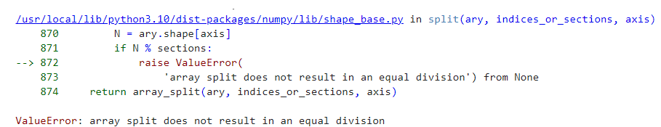
Example://split a 1D array to 3 parts
import numpy as np
arr = np.array([1, 2, 3, 4, 5, 6])
newarr = np.split(arr, 4)
print(newarr)

Slide 96
Splitting Array
Example://split a 1D array to 3 parts
import numpy as np
arr = np.array([1, 2, 3, 4, 5, 6])
newarr = np. array_split (arr, 4)
print(newarr)
[array([1, 2]), array([3, 4]), array([5]), array([6])]

Slide 97
import numpy as np
arr = np.array([1, 2, 3, 4, 5, 6])
newarr = np.array_split(arr, 3)
print(newarr[0])
print(newarr[1])
print(newarr[2])
[1 2]
[3 4]
[5 6]

Slide 98
Splitting 2-D Arrays
Use the same syntax when splitting 2-D arrays.
Use the array_split() method, pass in the array you want to split and the number of splits you want to do.
Example:
import numpy as np
arr = np.array([[1, 2], [3, 4], [5, 6], [7, 8], [9, 10], [11, 12]])
newarr = np.array_split(arr, 3)
print(newarr)
[array([[1, 2],
[3, 4]]), array([[5, 6],
[7, 8]]), array([[ 9, 10],
[11, 12]])]

Slide 99
Splitting 2-D Arrays
In addition, you can specify which axis you want to do the split around.
The example below also returns three 2-D arrays, but they are split along the row (axis=1).
Example:
import numpy as np
arr = np.array([[1, 2, 3], [4, 5, 6], [7, 8, 9], [10, 11, 12], [13, 14, 15], [16, 17, 18]])
newarr = np.array_split(arr, 3, axis=1)
print(newarr)
[array([[ 1],
[ 4],
[ 7],
[10],
[13],
[16]]), array([[ 2],
[ 5],
[ 8],
[11],
[14],
[17]]), array([[ 3],
[ 6],
[ 9],
[12],
[15],
[18]])]

Slide 100
import numpy as np
arr = np.array([[1, 2, 3], [4, 5, 6], [7, 8, 9], [10, 11, 12], [13, 14, 15], [16, 17, 18]])
newarr = np.array_split(arr, 3, axis=0)
print(newarr)
[array([[1, 2, 3],
[4, 5, 6]]), array([[ 7, 8, 9],
[10, 11, 12]]), array([[13, 14, 15],
[16, 17, 18]])]

Slide 101
Splitting 2-D Arrays
Use the hsplit() method to split the 2-D array into three 2-D arrays along rows.
Example:
import numpy as np
arr = np.array([[1, 2, 3], [4, 5, 6], [7, 8, 9], [10, 11, 12], [13, 14, 15], [16, 17, 18]])
newarr = np.hsplit(arr, 3)
print(newarr)
[array([[ 1],
[ 4],
[ 7],
[10],
[13],
[16]]),
array([[ 2],
[ 5],
[ 8],
[11],
[14],
[17]]),
array([[ 3],
[ 6],
[ 9],
[12],
[15],
[18]])]

Slide 102
import numpy as np
arr = np.array([[1, 2, 3], [4, 5, 6], [7, 8, 9], [10, 11, 12], [13, 14, 15], [16, 17, 18]])
newarr = np.vsplit(arr, 3)
print(newarr)
[array([[1, 2, 3],
[4, 5, 6]]), array([[ 7, 8, 9],
[10, 11, 12]]), array([[13, 14, 15],
[16, 17, 18]])]

Slide 103
import numpy as np
arr = np.array([[[1, 2, 3], [4, 5, 6]], [[7, 8, 9], [10, 11, 12]], [[13, 14, 15], [16, 17, 18]]])
np.dsplit(arr,[2,3])
[array([[[ 1, 2],
[ 4, 5]],
[[ 7, 8],
[10, 11]],
[[13, 14],
[16, 17]]]),
array([[[ 3],
[ 6]],
[[ 9],
[12]],
[[15],
[18]]]),
array([], shape=(3, 2, 0), dtype=int64)]

Slide 104
INTRODUCTION TO PANDAS

Slide 105
Pandas Introduction
Pandas is an open-source library that is built on top of NumPy library. It is a Python package that offers various data structures and operations for manipulating numerical data and time series. It is mainly popular for importing and analyzing data much easier. Pandas is fast and it has high-performance & productivity for users.

Slide 106
What is Pandas Libray in Python?
Pandas is a powerful and versatile library that simplifies the tasks of data manipulation in Python. Pandas is well-suited for working with tabular data, such as spreadsheets or SQL tables.
The Pandas library is an essential tool for data analysts, scientists, and engineers working with structured data in Python.

Slide 107
What is Python Pandas used for?
The Pandas library is generally used for data science, but have you wondered why? This is because the Pandas library is used in conjunction with other libraries that are used for data science.
It is built on top of the NumPy library which means that a lot of the structures of NumPy are used or replicated in Pandas.
The data produced by Pandas is often used as input for plotting functions in Matplotlib, statistical analysis in SciPy, and machine learning algorithms in Scikit-learn.

Slide 108
Here is a list of things that we can do using Pandas.
Data set cleaning, merging, and joining.
Easy handling of missing data (represented as NaN) in floating point as well as non-floating point data.
Columns can be inserted and deleted from DataFrame and higher-dimensional objects.
Powerful group by functionality for performing split-apply-combine operations on data sets.
Data Visualization.

Slide 109
Installing Pandas
The first step in working with Pandas is to ensure whether it is installed in the system or not. If not, then we need to install it on our system using the pip command.
Follow these steps to install Pandas:
Step 1: Type ‘cmd’ in the search box and open it. Step 2: Locate the folder using the cd command where the python-pip file has been installed. Step 3: After locating it, type the command:
pip install pandas

Slide 110
TYPES OF DATA STRUCTUE IN PANDAS
Data Structure | Dimensions | Description
 | 1 | 1D labeled homogeneous array, sizeimmutable.
ata Frames | 2 | General 2D labeled, size-mutable tabular structure with potentially heterogeneously typed columns.
Panel | 3 | General 3D labeled, size-mutable array.

Slide 111
SERIES
Series is a one-dimensional array like structure with homogeneous data. For example, the following series is a collection of integers 10, 23, 56, …
10 | 23 | 56 | 17 | 52 | 61 | 73 | 90 | 26 | 72

Slide 112
DataFrame
DataFrame is a two-dimensional array with heterogeneous data. For example,
Name | Age | Gender | Rating
Steve | 32 | Male | 3.45
Lia | 28 | Female | 4.6
Vin | 45 | Male | 3.9
Katie | 38 | Female | 2.78

Slide 113
Data Type of Columns
Column | Type
Name | String
Age | Integer
Gender | String
Rating | Float

Slide 114
PANEL
Panel is a three-dimensional data structure with heterogeneous data. It is hard to represent the panel in graphical representation. But a panel can be illustrated as a container of DataFrame.

Slide 115
DataFrame
A Data frame is a two-dimensional data structure, i.e., data is aligned in a tabular fashion in rows and columns.
Features of DataFrame
Potentially columns are of different types
Size – Mutable
Labeled axes (rows and columns)
Can Perform Arithmetic operations on rows and columns

Slide 116
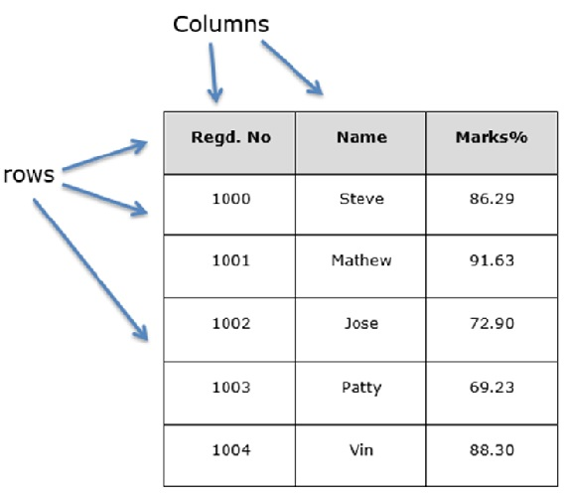
Structure

Slide 117
pandas.DataFrame
pandas.DataFrame(data, index , columns , dtype , copy )

Slide 118
data
data takes various forms like ndarray, series, map, lists, dict, constants and also another DataFrame.
index
For the row labels, the Index to be used for the resulting frame is Optional Default np.arrange(n) if no index is passed.
columns
For column labels, the optional default syntax is - np.arrange(n). This is only true if no index is passed.
dtype
Data type of each column.
copy
This command (or whatever it is) is used for copying of data, if the default is False.

Slide 119
Create DataFrame
A pandas DataFrame can be created using various inputs like −
Lists
dict
Series
Numpy ndarrays
Another DataFrame

Slide 120
Example
Example
import pandas as pd
Data = [_______]
Df = pd.DataFrame(data)
Print df
Example 2
Import pandas as pd
Data = {‘Name’ : [‘__’. ‘__’],’Age’: [___]}
Df = pd.DataFrame(data) print df

Slide 121
Example
import pandas as pd
data = [{'a': 1, 'b': 2},{'a': 5, 'b': 10, 'c': 20}]
df = pd.DataFrame(data)
print df
________________________________________
import pandas as pd
data = [{'a': 1, 'b': 2},{'a': 5, 'b': 10, 'c': 20}]
df = pd.DataFrame(data, index=['first', 'second'])
print df

Slide 122
import pandas as pd
data = [{'a': 1, 'b': 2},{'a': 5, 'b': 10, 'c': 20}]
#With two column indices, values same as dictionary keys
df1 = pd.DataFrame(data, index=['first', 'second'], columns=['a', 'b'])
#With two column indices with one index with other name
df2 = pd.DataFrame(data, index=['first', 'second'], columns=['a', 'b1'])
print df1print df2

Slide 123
The following example shows how to create a DataFrame with a list of dictionaries, row indices, and column indices.
import pandas as pd
data = [{'a': 1, 'b': 2},{'a': 5, 'b': 10, 'c': 20}]
#With two column indices, values same as dictionary keys
df1 = pd.DataFrame(data, index=['first', 'second'], columns=['a', 'b'])
#With two column indices with one index with other name
df2 = pd.DataFrame(data, index=['first', 'second'], columns=['a', 'b1'])
print df1
print df2

Slide 124
Create a DataFrame from Dict of Series
import pandas as pd
d = {'one' : pd.Series([1, 2, 3], index=['a', 'b', 'c']), 'two' : pd.Series([1, 2, 3, 4], index=['a', 'b', 'c', 'd'])}
df = pd.DataFrame(d)
print df

Slide 125
Column Addition
import pandas as pd
d = {'one' : pd.Series([1, 2, 3], index=['a', 'b', 'c']), 'two' : pd.Series([1, 2, 3, 4], index=['a', 'b', 'c', 'd'])}
df = pd.DataFrame(d)
# Adding a new column to an existing DataFrame object with column label by passing new series
print ("Adding a new column by passing as Series:")
df['three']=pd.Series([10,20,30],index=['a','b','c'])
print dfprint ("Adding a new column using the existing columns in DataFrame:")
df['four']=df['one']+df['three']
print df

Slide 126
Column Deletion
# Using the previous DataFrame, we will delete a column
# using del function
import pandas as pd
d = {'one' : pd.Series([1, 2, 3], index=['a', 'b', 'c']), 'two' : pd.Series([1, 2, 3, 4], index=['a', 'b', 'c', 'd']), 'three' : pd.Series([10,20,30], index=['a','b','c'])}
df = pd.DataFrame(d)

Slide 127
print ("Our dataframe is:")
print df
# using del function
print ("Deleting the first column using DEL function:")
del df['one']
print df # using pop function
print ("Deleting another column using POP function:")
df.pop('two')
print df

Slide 128
Slicing in python
import pandas as pd d = {'one' : pd.Series([1, 2, 3], index=['a', 'b', 'c']), 'two' : pd.Series([1, 2, 3, 4], index=['a', 'b', 'c', 'd'])}
df = pd.DataFrame(d)
print df[2:4]

Slide 129
Addition of rows
Df2 = pd.DataFrame([[5,6], [7,8]], columns = [‘a’, ‘b’])
Df = df.append(df2 )
Print df
Deletion of rows
Df2 = pd.DataFrame([[5,6], [7,8]], columns = [‘a’, ‘b’])
Df = df.drop(0)
Print df

Slide 130
Reindexing
import pandas as pd
import numpy as np df1 = pd.DataFrame(np.random.randn(10,3),columns=['col1','col2','col3'])
df2 = pd.DataFrame(np.random.randn(7,3),columns=['col1','col2','col3'])df1 = df1.reindex_like(df2)print df1

Slide 131
Concatenating objects
import pandas as pd
One = pd.DataFrame({ ‘Name’: [‘__’] , ‘subject_id’: [‘__’], ‘marks’: [‘__’]}, index = [] )
two= pd.DataFrame({ ‘Name’: [‘__’] , ‘subject_id’: [‘__’], ‘marks’: [‘__’]}, index = [] )
Print pd.concat([one, two])

Slide 132

Handling categorical data
There are many data that are repetitive for example gender , country , and codes are always repetitive .
Categorical variables can take on only a limited
The categorical data type is useful in the following cases −
A string variable consisting of only a few different values. Converting such a string variable to a categorical variable will save some memory.
The lexical order of a variable is not the same as the logical order (“one”, “two”, “three”). By converting to a categorical and specifying an order on the categories, sorting and min/max will use the logical order instead of the lexical order.
As a signal to other python libraries that this column should be treated as a categorical variable (e.g. to use suitable statistical methods or plot types).

Slide 133
import pandas as pd
cat = pd.Categorical(['a', 'b', 'c', 'a', 'b', 'c'])
print cat
____________________________________________
import pandas as pd
import numpy as np
cat = pd.Categorical(["a", "c", "c", np.nan], categories=["b", "a", "c"])
df = pd.DataFrame({"cat":cat, "s":["a", "c", "c", np.nan]})
print df.describe()
print df["cat"].describe()

